Slide 1
THE BIG PITCH
Accelerate your Microsoft marketing with 50/50 co-funding and agency-backed support.
Westcoast Cloud x Marketbridge
December 2025

Slide 2
OVERVIEW
What is the Big Pitch
Two ways to use the Big Pitch
How you will benefit
How the Big Pitch works
Packages
Success with the Big Pitch
Top tips
Service levels
Getting started

Slide 3
WHAT IS
THE BIG PITCH

Slide 4
WHAT IS THE BIG PITCH
As a Westcoast Cloud partner, you know the Microsoft products and services your customers are interested in. But you might not always have the budget to promote them.
That’s where the Big Pitch comes in. All you need to do is pitch your Microsoft-focused marketing activity to us: tell us what you want to do, how much it will cost and the return on investment you’re aiming for.
Then, once the campaign has finished, simply show us what you’ve done, and we’ll return 50% of the investment.
One thing to stress – and we delve into this more throughout – is that you’ll need to provide us with the Proof of Execution (POE), which shows us (and Microsoft!) that you’ve spent the funding we’ve sent you.
The Big Pitch is Westcoast Cloud’s 50/50 Marketing Development Fund (MDF) that helps partners run impactful Microsoft marketing campaigns.
Get 50% funding on approved activity
Access expert strategic and creative support
Build scalable marketing that drives real pipeline

Slide 5
TWO WAYS TO USE THE BIG PITCH
Choose the approach that works best for your business.
The Big Pitch is designed to be flexible. You can choose to run campaigns independently or unlock additional value through Westcoast Cloud’s agency-backed model.
Both routes provide access to 50/50 co-funding, but the level of support, structure and assurance differs.

Slide 6
RUNNING YOUR CAMPAIGN INDEPENDENTLY
For partners who want full control
You can choose to:
Develop your own campaign idea
Build and submit your MDF proposal
Execute the activity using your internal or external resources
Collect and submit Proof of Execution (POE)
Produce and submit final reporting
What this gives you
Full creative and operational control
Flexibility to work in your own way
Access to 50/50 MDF reimbursement (subject to approval and compliance)
Important to note
You are responsible for ensuring your submission, POE and reporting fully align with Microsoft’s strict MDF requirements
Approval, reimbursement and claim success depend on accuracy, compliance and completeness
Westcoast Cloud provides guidance but does not manage or validate execution under this route

Slide 7
THE AGENCY-BACKED BIG PITCH (RECOMMENDED)
Westcoast Cloud has introduced an optional, agency-backed approach designed to elevate campaign quality, reduce risk and simplify MDF delivery.
What’s different
Strategic planning support aligned to Microsoft priorities
Professionally built proposal decks designed for approval success
Campaign execution managed by a Microsoft-experienced agency
Midway reporting and full POE packs handled for you
Structured timelines, governance and service levels
Why this helps
Reduces internal workload and admin burden
Minimises risk of rejected or delayed claims
Improves campaign effectiveness and ROI
Ensures POE and reporting meet Microsoft’s exact standards
Gives you confidence that funding will be successfully reclaimed
This is not just funding support; it’s end-to-end campaign delivery with MDF assurance built in.

Slide 8
CLEAR EXPECTATIONS
Transparency is key
To avoid any confusion:
Packages and agency support apply only when using the agency-backed model
Partners running campaigns independently do not receive the same service levels, execution or POE support
Please always be clear about which route you are choosing
Our goal is simple:
Whether you want full control or full support, the Big Pitch is built to work around you with clarity, confidence and compliance at its core.

Slide 9
HOW YOU
WILL BENEFIT

Slide 10
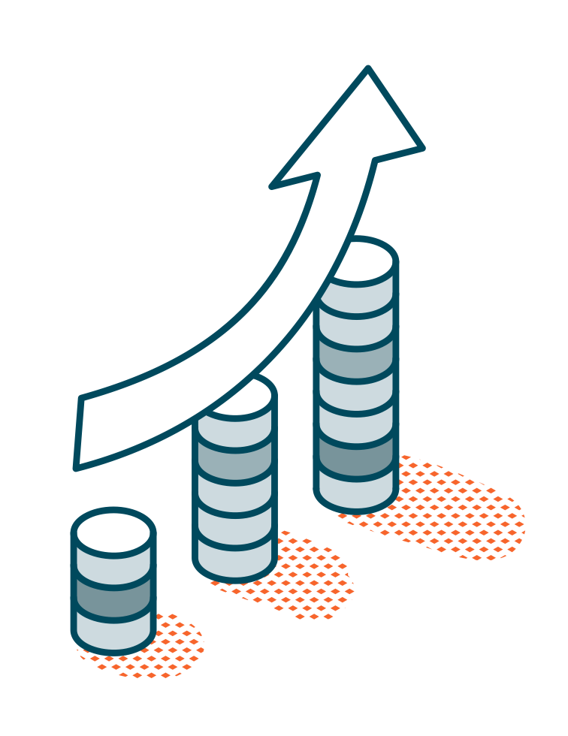



BENEFITS
Whether taking the independent or agency route, the BIG PITCH offers multiple benefits to you.
Grow faster with less risk
Support that moves at your pace
Accelerate ROI
Double the impact of your marketing budget with 50/50 matched funding
Reduce internal strain with ready-made structures, templates and creative support
Insight-driven plans built around your goals if using agency support
Faster approvals and reduced admin
Expert guidance to make the most of every funding cycle
Build high-quality campaigns aligned to Microsoft priorities
Strengthen customer engagement and pipeline conversion

Slide 11
HOW THE
BIG PITCH WORKS

Slide 12






HOW THE BIG PITCH WORKS
The process is really simple! If you want to run your own campaign, submit your idea to us, and we’ll set the wheels in motion for your MDF claim.
Submission: Send us your pitch! No need to go too in depth – we just need the key details
Approval: Westcoast Cloud reviews and confirms funding – feedback is available at this stage
Execute: Get your campaign started – just make sure it’s all done in the agreed timeframe
Proof: Send us your POE by the agreed deadline. Don’t forget to make sure it ticks all the Microsoft guideline boxes
Reporting: Send a post-campaign report 2 months after your POE, so we can track the funding’s impact on your winning idea
Reimbursement: Once the POE has been provided, Westcoast Cloud will send over the agreed payment

Slide 13




HOW THE BIG PITCH WORKS
If you choose to use our agency support with one of our pre-packaged marketing activities, or already have something in mind, the process is still very straightforward.
Discovery call: Explore ideas and define objectives with you
Select package (if using): Choose from £10K / £15K / £20K*
Proposal build: Our agency partner creates a ready-for-submission deck to support your pitch idea
Approval: Westcoast Cloud reviews and confirms funding – feedback is available at this stage
POs issued: To start agency support and campaign creation, a PO must be raised by you
Execute: Our agency partner will activate your campaign aligned with agreed timeframes
POE and reporting: Our agency partner provides a full POE pack and a mid-way report is provided
Reimbursement: Once the POE has been provided, Westcoast Cloud will send over the agreed payment
* This is the total cost of the activity, so a £10k package would be £5k from you and £5k from us

Slide 14
PACKAGES

Slide 15



PACKAGE OPTIONS
We know you’re busy, so we’ve created ready-to-run campaign packages that make it easy to unlock MDF, accelerate approvals and drive real outcomes.
Each package combines strategic thinking, high-quality creative and expert execution, all backed by 50/50 co-funding.
Prefer something bespoke? No problem. These packages are a starting point – you’re always welcome to pitch your own idea through the Big Pitch.
Awareness boost
Thought leadership
Conversion
Event

Slide 16
PACKAGE OPTIONS
Awareness boost: £10,000
(£5k from you, £5k from us!)
Put your cloud proposition firmly on the radar
Designed to build visibility and credibility with your target audience, this package helps you show up consistently and professionally across key digital touchpoints.
What you get
HTML email to spark initial engagement
Campaign landing page elements
3 x static LinkedIn social posts
Copy variations for organic social or email follow-ups
Agency project management included
Best for: Early-stage awareness, new propositions, or warming up accounts for future demand generation.

Slide 17
PACKAGE OPTIONS
Thought leadership: £15,000
(£7.5k from you, £7.5k from us!)
Be seen as the expert your customers trust
Position your business as a credible voice in AI and cloud innovation with insight-led content that educates, inspires and builds authority.
What you get
Campaign landing page elements
Long-form thought leadership blog (800–1000 words)
Professionally designed 2-page PDF eGuide
2 x LinkedIn static social posts
Distribution guide for LinkedIn or email nurture
Agency project management included
Best for: Building trust, nurturing senior decision-makers and supporting longer sales cycles.

Slide 18
PACKAGE OPTIONS
Conversion: £20,000
(£10k from you, £10k from us!)
Turn interest into action
This package is designed to generate qualified leads and enquiries for specific cloud solutions, with content and assets built to move prospects down the funnel.
What you get
Everything in the Awareness package
Infographic-style solution/benefits one-pager
Customer case study
Email copy for direct outreach
Web banner or display ad creative for retargeting
Lead-capture landing page with follow-up asset
Agency project management included
Best for: Driving pipeline, accelerating opportunities and supporting sales teams with tangible assets.

Slide 19
PACKAGE OPTIONS
Event: £20,000
(£10k from you, £10k from us!)
Maximise the impact of your events – before, during and after
Whether in-person or virtual, this package helps you create a cohesive event experience that drives engagement and follow-up conversations.
What you get
Event creative identity and booth graphics
Pre-event email and social promotion toolkit
Post-event nurture content
Optional short video or customer story for event use
Agency project management included
Best for: Customer events, Microsoft-aligned activations and high-touch engagement moments.

Slide 20






ADDITIONAL CONTENT
Looking to go further? You can bolt on additional assets to strengthen your campaign, extend reach or support follow-up activity. Mix and match to suit your goals.
Newsletter email
£1,440
Email
£1,200
1 x long-form email with four content sections to get your messaging across
1 x simple email with two content sections for more focused messaging
eGuide
£5,400
Infographic
£4,200
1 x 6-8 page PDF to act as a hero content piece for your campaign
1 x long-form stat led content piece to add leverage to your campaign
LinkedIn GIF ad
£900
2D animation video
£2,400
20 seconds
1 x animated GIF ad to support activating your campaign on LinkedIn
1 x 20 second engaging and snappy video for use on social

Slide 21






ADDITIONAL CONTENT
Looking to go further? You can bolt on additional assets to strengthen your campaign, extend reach or support follow-up activity. Mix and match to suit your goals.
One pager
£1,440
Battlecard
£2,160
1 x 1-page PDF to help give a topline overview of your key messaging
1 x 1-page PDF to help answer any key questions or show USPs
Web banner/email signature
£360
LinkedIn carousel ad
£1,200
1 x banner to support activating your campaign
1 x 3-card carousel ad to support activating your campaign on LinkedIn
Social campaign set up
£480
Social campaign
£960
2-week activation management
Set up of a paid LinkedIn campaign with ad type
Management and ongoing optimisation of a 2-week LinkedIn campaign

Slide 22
SUCCESS WITH THE BIG PITCH

Slide 23
OUR PARTNER SUCCESS STORIES
Partners we've supported have achieved:
+108%
+17%
Growth in services trading in a single quarter
Growth device trading
Consistent uplift in lead acquisition and sales enablement outcomes
Action WCC:
What example success stories or data do we have to support this slide

Slide 24
TOP TIPS

Slide 25
TOP TIPS FOR SUCCESS WITH THE BIG PITCH
TOP TIPS FOR SUCCESS WITH THE BIG PITCH
The biggest one of all
Read the terms and conditions. It’s crucial you understand what you’re getting into, especially when failure to comply can void your campaign and, consequently, your funding. No one wants that, so make sure you’re fully on board with the terms by heading to westcoastcloud.co.uk/marketing-development-fund/
Read the official guidebook
For more info, such as the full details of what each campaign type needs, check out the Microsoft Partner Incentives Co-Op Guidebook, which you can get from us at thrive@westcoastcloud.co.uk
Don’t forget the date
Include dates of events on the POE – seriously. Microsoft needs them to accept campaign claims. This could be proving a claim for an email campaign with a screenshot showing the email and its send date, a webpage screenshot that includes your monitor’s date from the taskbar or an event-invite screenshot that shows the all-important start date.
Don’t be afraid to mix things up
Why limit yourself to just one event or chain of emails? This funding covers 50% of your campaign, so make the most of it. Link different activities together and – as long as it’s all within the right dates and follows Microsoft guidelines – it’ll count as one activity.
Make sure Microsoft is there
We don’t necessarily mean physically. But seeing as they’re paying for this exposure, you’ll need to make them the focus. Basically, Microsoft should be the main character of your marketing materials – ideally the only vendor you promote. But if others must be included, then it’s crucial to keep it at least 80/20 in Microsoft’s favour.
All non-negotiables
There must be a midway report to show progress
All submissions/bids must be a minimum of £5k
All non-negotiables
There must be a midway report to show progress
All submissions/bids must be a minimum of £5k

Slide 26
TERMS AND CONDITIONS
The following terms and conditions govern the eligibility and disbursement of funding under the Big Pitch initiative. By submitting an application, the Partner agrees to comply with all provisions outlined below:
Application Timing and Eligibility
Applications will be reviewed at the beginning of each fiscal half-year for campaigns scheduled to be executed within that same half-year. Applications submitted prior to the official opening of the registration window will be deemed ineligible and discarded. Only campaigns planned for the current half-year will be considered. Campaigns must be Microsoft-focused to be considered.
Funding Structure and Investment Matching
The Big Pitch initiative operates on a 50/50 co-investment model. Partners are required to match the funding amount requested. For example, if a campaign has a total cost of £8,000, the Partner and WCC must each contribute £4,000. In this case, the Partner should apply for £4,000 in the “Funding amount requested” field of the application form, representing our 50% share of the total campaign cost.
Campaign Completion and Proof of Execution (POE)
All campaign activities must be completed, and the corresponding POE must be submitted by 31 May for H1 campaigns, or 30 November for H2 campaigns. To qualify as valid POE, third-party invoices must be settled in GBP or EUR.
Post-Campaign Reporting Requirements
Partners must submit a report detailing the campaign performance against set targets & objectives by 31 July for H1 campaigns, or by 31 December for H2 campaigns.
Funding Disbursement Conditions
Funding will be disbursed only after verification of the full completion of all deliverables, including: execution of the marketing campaign, submission of all required proof-of-execution (POE) documentation, and fulfilment of post-campaign reporting requirements. No advance payments will be made. Disbursement will be processed via a separate credit note issued to the Partner’s account.
Non-Compliance
Failure to comply with any of the above terms and conditions will render the agreement void, and the Partner will forfeit any entitlement to funding.

Slide 27
SERVICE LEVELS

Slide 28
OUR SERVICE LEVELS*
Our commitment to you:
Availability: Monday–Friday, 9am–5:30pm
Response times:
  Email acknowledgement within 8 working hours
  Call-back or meeting scheduled within 2 working hours upon request
Transparency: Clear timelines and milestone updates
Support: Dedicated inbox for all queries
Quality: POE delivered promptly following campaign completion
We’re here to make your Big Pitch experience smooth, structured and high-impact.
* This applies to agency-supported activity only, if you are managing your own campaign the above is not applicable

Slide 29
GETTING STARTED

Slide 30

HOW TO ENGAGE
Connect
Shape
Deliver
Submit your Big Pitch application through our website, including the details of your preferred package – Awareness, Thought leadership, Conversion, Events or your own campaign.
Join a planning call to explore ideas, learn more about the packages or discuss your planned activity and finalise your proposal.
Our partner agency will build your assets and support POE throughout activation of your campaign.
Roles:
Westcoast Cloud: Approves plans and manages MDF reimbursement
Partner agency: Provides strategic, creative and operational support throughout and activation of the campaign
You: Give us the brief and business context
30 | Partner Launch Deck

Slide 31
GETTING STARTED
Getting started is simple:
Submit your Big Pitch application via the website
Let us know your preferred package or if you have your own plan
Book your planning session
Start building your campaign
Together, we’ll help you get the most from your Microsoft co-funding.
Big Pitch application
Big Pitch - Apply
Big Pitch Inbox
[insert email]
Partner agency – Marketbridge
[insert contact names & emails]
Westcoast Cloud Marketing Team
[insert contact(s)]
Action WCC:
Advise on the email alias/account + contact details

